Slide 1
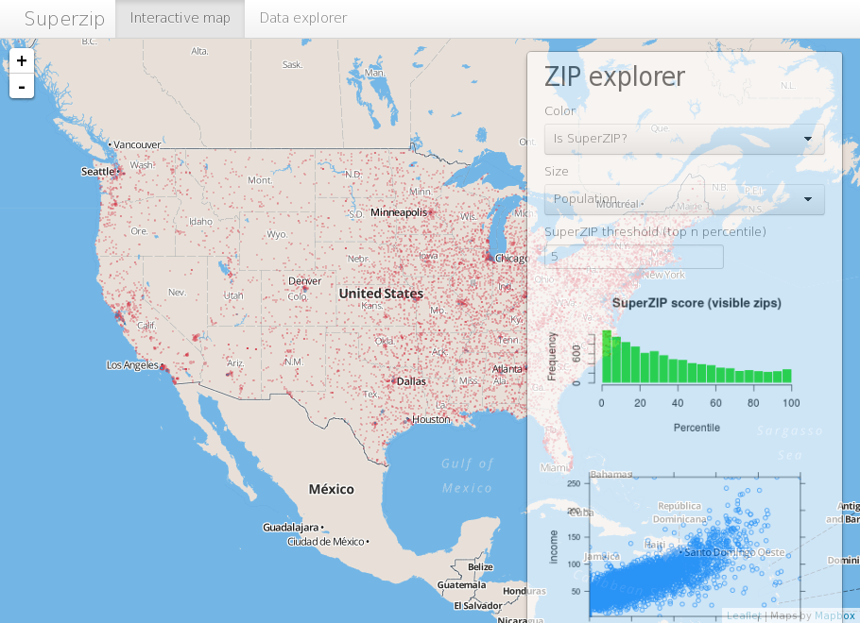
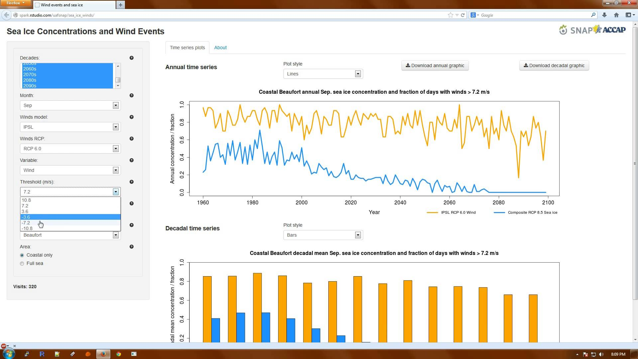
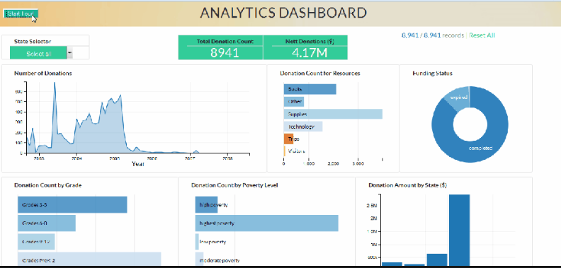
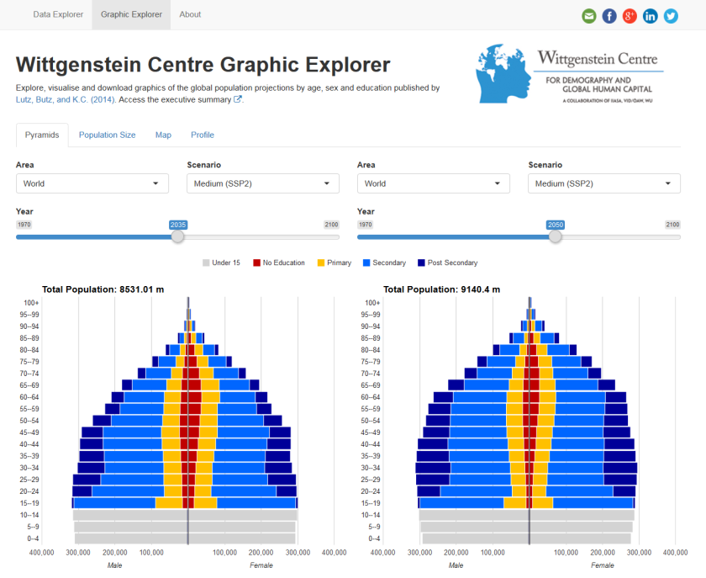
Shiny Apps Build Interactive Web Applications With R
Prepared by
Aep Hidayatuloh
aef.stk@gmail.com

Slide 2

Welcome to Shiny
Shiny is an R package that makes it easy to build interactive web applications (apps) straight from R.
i.e. Entry data form, analytic dashboard etc.
The default styling of a Shiny application is clean and effective.
Very extensible and it is easy to integrate Shiny applications with your own web content using HTML and CSS.
JavaScript and jQuery can also be used to further extend the scope of Shiny applications.

Slide 3
Requirement
Tools
Latest version of R or Microsoft R Open (64-bit only)
Latest version of RStudio and shiny package
Browser (Mozilla Firefox, Google Chrome etc.)
Knowledge
R programming
Basic web knowledges

Slide 4
What will be discussed?
Basic Shiny Apps
Basic components of Shiny Apps
Build Interactive Shiny Apps
Publish Apps
Create and setting account
Publish and access the apps

Slide 5
Lets Get Started!
Install R/Microsoft R Open and RStudio
R : https://cran.r-project.org/
MRO : https://mran.microsoft.com/open
RStudio : https://www.rstudio.com/products/rstudio/download/
Install shiny package
install.packages("shiny")

Slide 6
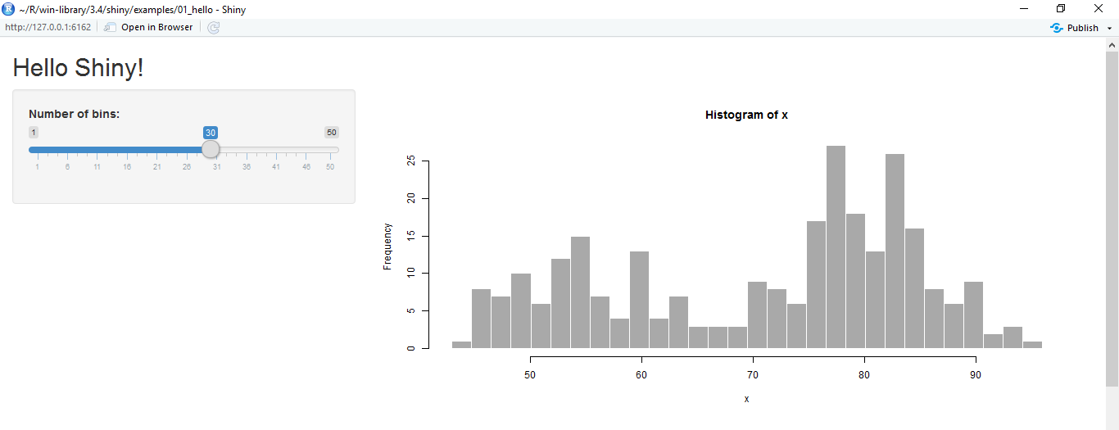
Hello Shiny!
library(shiny)
runExample("01_hello")

Slide 7
Basic Shiny Apps
Layout
Title/Header Panel
Sidebar/Input Panel
Main/Output Panel
You can create shiny apps with single file app.R or two files ui.R and server.R
ui.R
server.R
User Interface
Computation Processes

Slide 8
Shiny ui.R and server.R
ui.R
server.R
User Interface
Control the layout, appearance, widget for user inputs and display the output.
Eg. the title, page layout, text input, radio button, dropdown menu, graphics output etc.
Server
Set of instructions that uses the input provided by user, process them and produces the required output which is further displayed by ui.R

Slide 9
Build Our First Apps

Slide 10
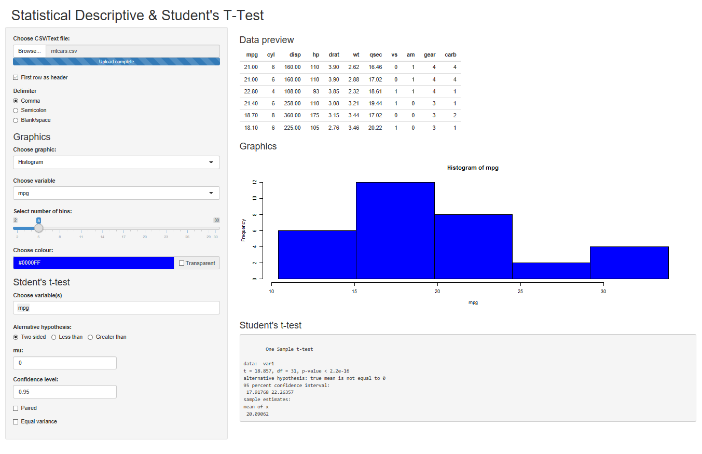
Statistical Descriptive Apps
Create an app to display statistical descriptive with graphics (histogram, boxplot and scatter plot)
We will also use colourpicker package to create colour picker widget for the graphs.
Use install.packages("colourpicker")
The full code is available on https://github.com/aephidayatuloh/descriptive

Slide 11
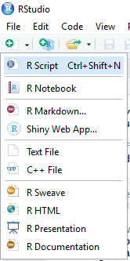
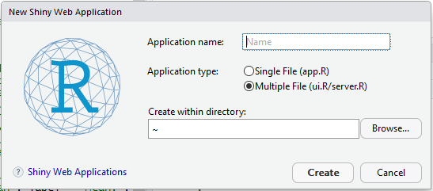
Build App
Create shiny apps template from RStudio
Provide Application name
Choose Multiple File(ui.R/server.R) for Application Type
Select folder for created shiny apps

Slide 12
Basic Shiny App Code
ui.R
server.R
library(shiny)
library(colourpicker)
shinyUI(
fluidPage(
headerPanel("Statistical Descriptive"),
sidebarLayout(
sidebarPanel("Input Panel"),
mainPanel("Output Panel")
)
)
)
library(shiny)
library(colourpicker)
shinyServer(function(input, output){
})

Slide 13
Design the User Interface
sidebarPanel(
fileInput(inputId = "file", label = "Choose CSV/Text file:"),
checkboxInput(inputId = "header", label = "First row as header", value = TRUE),
radioButtons(inputId = "delim", label = "Delimiter", choices = list("Comma"=",", "Semicolon"=";", "Blank/space"="\t")),
h3("Graphics"),
selectInput(inputId = "graphs", label = "Choose graphic:",
choices = list("Histogram"="hist", "Boxplot"="boxplot", "Scatter"="scatter")),
conditionalPanel(condition = "input.graphs=='hist'",
selectInput(inputId = "column", label = "Choose variable", choices = list("")),
sliderInput(inputId = "bins", label = "Select number of bins:", value = 5, min = 2, max = 30)
),
conditionalPanel(condition = "input.graphs=='boxplot'",
selectInput(inputId = "boxcol", label = "Choose variable", choices = list(""), multiple = TRUE)
),
conditionalPanel(condition = "input.graphs=='scatter'",
selectInput(inputId = "var1", label = "Select variable 1", choices = list("")),
selectInput(inputId = "var2", label = "Select variable 2", choices = list("")),
sliderInput(inputId = "point", label = "Select point for plot:", value = 1, min = 1, max = 20)
),
colourInput(inputId = "cols", label = "Choose colour:", value = "blue", allowTransparent = TRUE, palette = "limited")
)

Slide 14
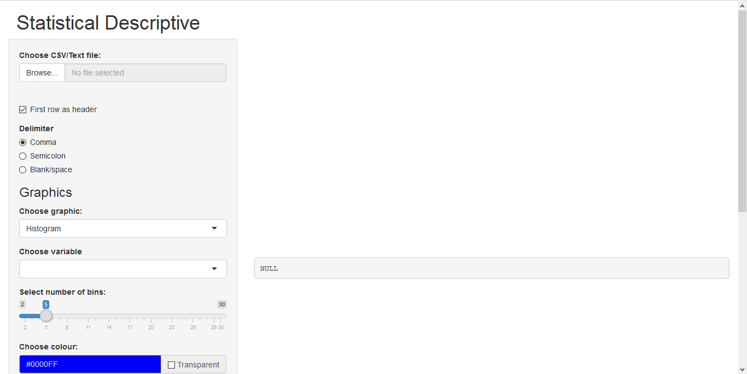
Design the Output Panel
sidebarPanel(
...
#input widget code
...
),
mainPanel(
uiOutput("tableTitle"),
tableOutput("preview"),
uiOutput("graphTitle"),
plotOutput("plots")
)
Run the app by click

Slide 15
Create the Brain
All processes are done in server.R.
First, read file from fileInput() with datapath of input$file
infile <- input$file
read.delim(infile$datapath, …)
All generated objects (vector, table, plot, text, UI etc.) based on input should be created in reactive function (reactive(), render*(), observe() etc.).
render*() → *Output()
ui.R | server.R
tableOutput("preview") | output$preview <- renderTable()
uiOutput("graphTitle") | output$graphTitle <- renderUI()
plotOutput("plots") | output$plots <- renderPlot()
printOutput("text") | output$text <- renderPrint()

Slide 16
Create the Brain – Read data & Preview
# Read the input file
dataset <- reactive({
if(is.null(input$file)){return(NULL)}
infile <- input$file
read.delim(infile$datapath, header = input$header, sep = input$delim)
})
# Title for preview table
output$tableTitle <- renderUI({
if(is.null(input$file)){return(NULL)}
h3("Data preview")
})
# Preview table
output$preview <- renderTable({
if(is.null(input$file)){return(NULL)}
head(dataset())
})

Slide 17
Create the Brain – Update Variable Name
# Update the input variable for graphs
observe({
if(!is.null(input$file) & input$graphs=="hist"){
vars <- names(dataset())
updateSelectInput(session, inputId = "column", label = "Choose variable", choices = vars, selected = vars[1])
updateSelectInput(session, inputId = "ttestcol", label = "Choose variable(s)", choices = vars, selected = vars[1])
}
else if(!is.null(input$file) & input$graphs=="boxplot"){
vars <- names(dataset())
updateSelectInput(session, inputId = "boxcol", label = "Choose variable", choices = vars, selected = vars[1])
}
else if(!is.null(input$file) & input$graphs=="scatter"){
vars <- names(dataset())
updateSelectInput(session, inputId = "var1", label = "Select variable 1", choices = vars, selected = vars[1])
updateSelectInput(session, inputId = "var2", label = "Select variable 2", choices = vars, selected = vars[2])
}
})

Slide 18
Create the Brain – Create Graphics
output$graphTitle <- renderUI({
if(is.null(input$file)){return(NULL)}
h3("Graphics")
})
output$plots <- renderPlot({
if(is.null(input$file)){return(NULL)}
x <- dataset()
if(input$graphs=="hist"){
bins <- seq(min(x[,input$column]), max((x[,input$column])), length.out = input$bins + 1)
hist(x[,input$column], breaks = bins, col = input$cols,
main = paste("Histogram of", input$column), xlab = input$column)
}
else if(input$graphs=="boxplot"){
boxplot(x[, input$boxcol])
}
else if(input$graphs=="scatter"){
plot(x[,c(input$var1, input$var2)], pch = input$point, xlab = input$var1, ylab = input$var2, col = input$cols)
}
})

Slide 19
Launch The App

Slide 20
Deploy Shiny Apps
There are two ways to deploy the apps :
Locally → you can run the apps on your own local machine (local server) or local area network (no need internet access).
Web → deploy your apps to the web hosting. Shinyapps.io is free!

Slide 21
Deploy Your Apps To Web
If you want your Shiny app to be accessible over the web, so that users only need a web browser and internet access.
Shinyapps.io is a platform as a service (PaaS) for hosting Shiny web apps.
Before you get started with shinyapps.io, you will need the latest version of the rsconnect R package,
install.packages("rsconnect")
and Create a shinyapps.io account.

Slide 22
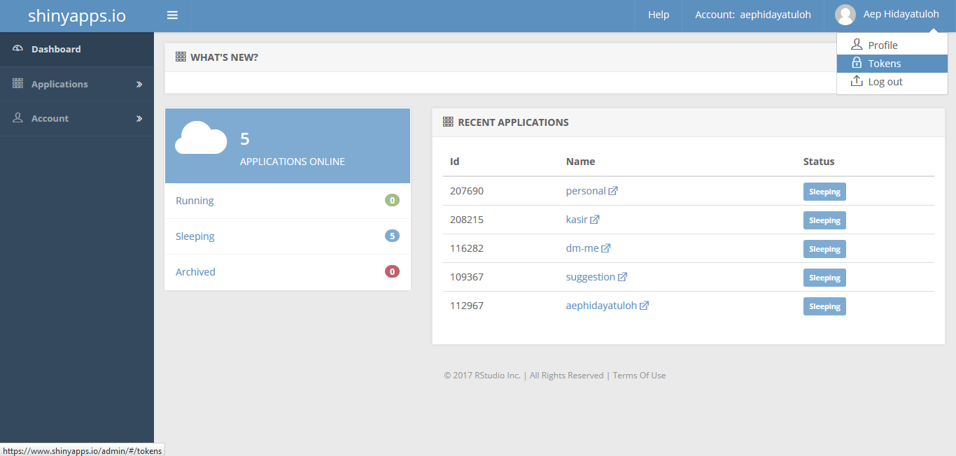
Create shinyapps.io Account
Go to https://www.shinyapps.io and create a new account by sign up or log in if you already have.

Slide 23
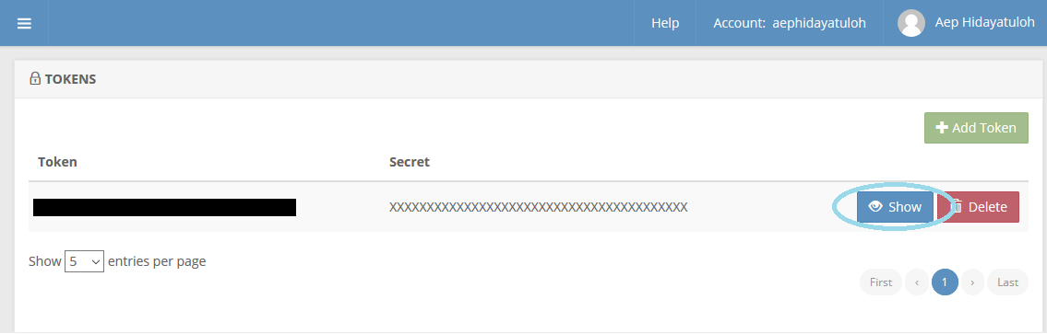
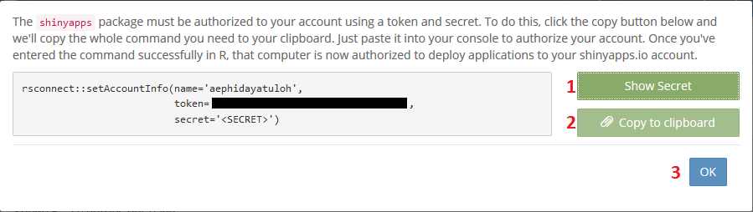
Generate Token
Generate token and copy

Slide 24
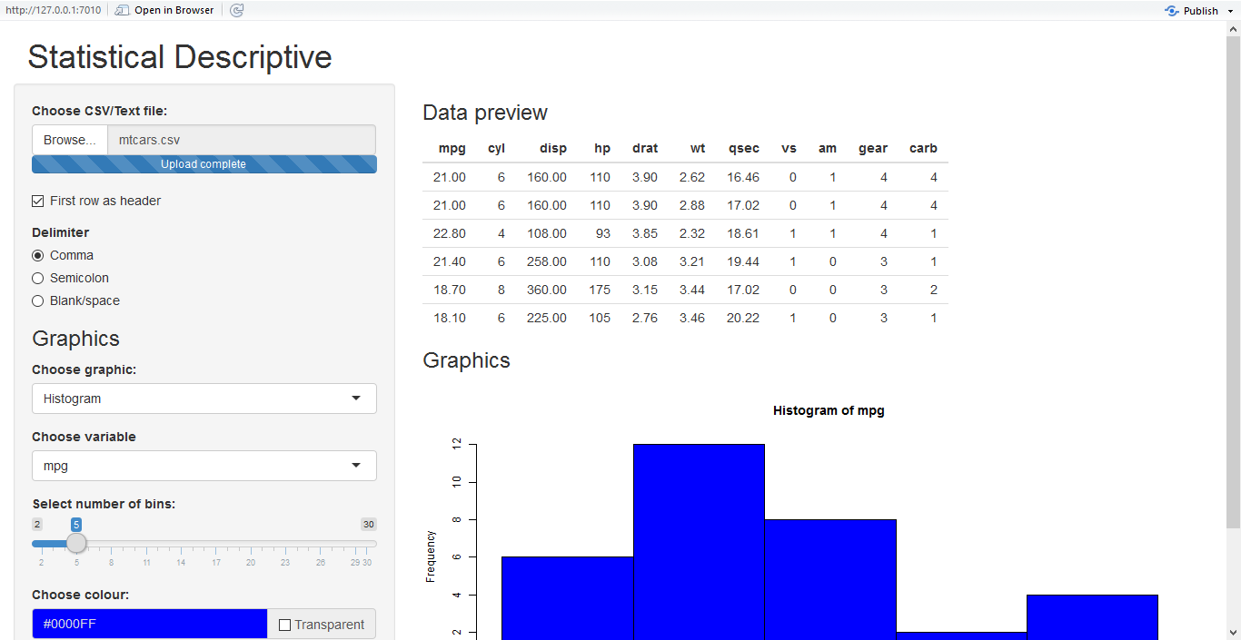

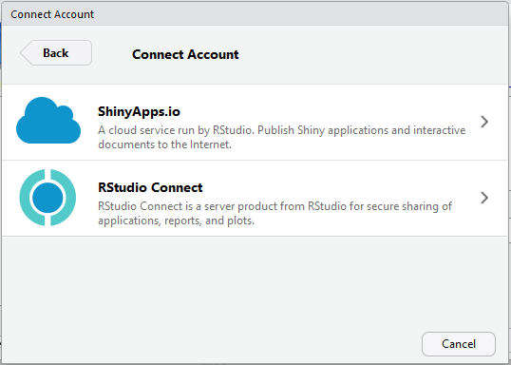
Publish Apps

Slide 25
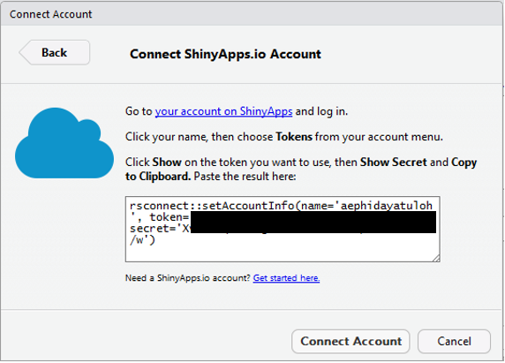
Setting Connection
Copy and Paste the copied token

Slide 26
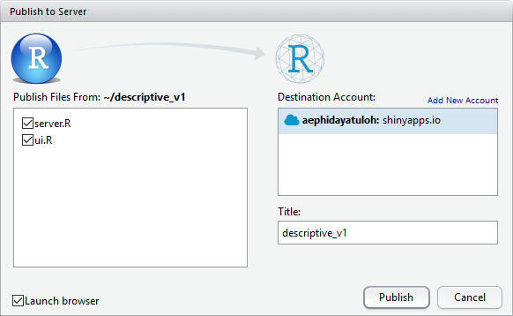
Apps Name
https://aephidayatuloh.shinyapps.io/descriptive_v1

Slide 27
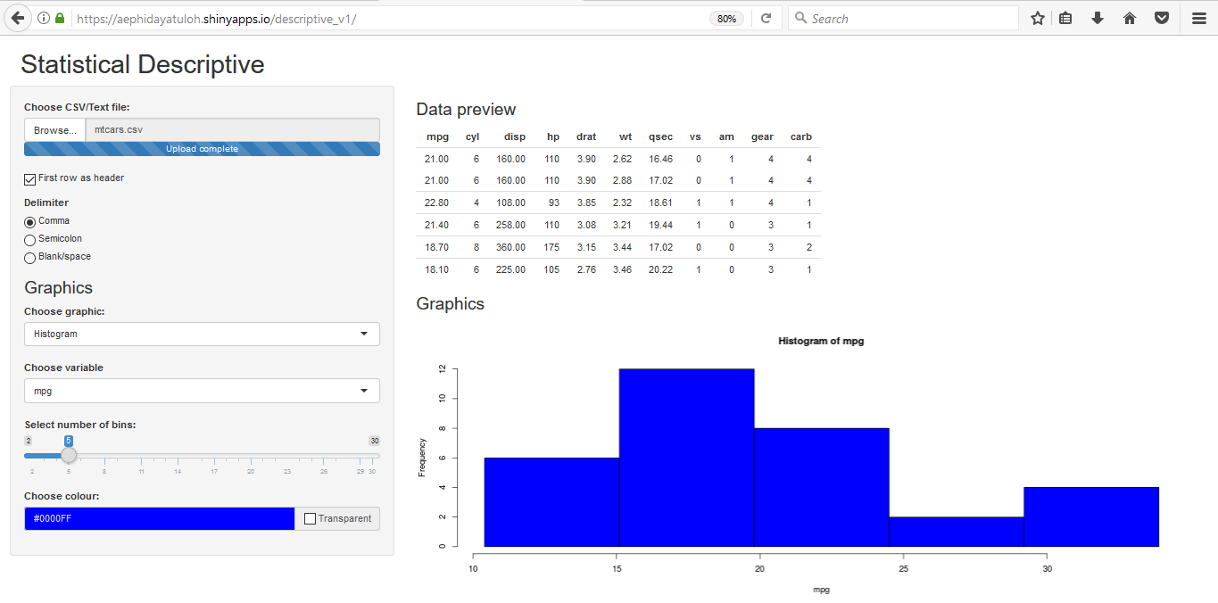
Access The Apps

Slide 28
Summary
We can create interactive apps for data visualization, i.e. dashboard, spatial maps etc, or data entry form.
Shiny apps is very extensible – HTML, CSS, JavaScript and JQuery.
Create Shiny Apps with UI and Server
Publish Shiny Apps – local or web; free or paid.
Code, data and this presentation file is available on https://github.com/aephidayatuloh/descriptive_v1 and https://github.com/aephidayatuloh/descriptive_v2

Slide 29


